Slide 1
TAX ISSUES WITH SUCCESSION PLANNING
OPPORTUNITIES
Joe Baldwin, EA
Farm Credit East
315-781-7100
Joseph.baldwin@
farmcrediteast.com

Slide 2
WHICH ENTITY TYPE IS THE BEST FOR SUCCESSION PLANNING?
?

Slide 3
WHICH ENTITY TYPE IS THE BEST FOR SUCCESSION PLANNING?
WHATEVER
JEFF FETTER
TELLS ME!
S CORPS
FOR LIFE!!!
NO WAY!
LLCS ALL DAY!

Slide 4
WHICH ENTITY TYPE IS THE BEST FOR SUCCESSION PLANNING?
WHATEVER
JEFF FETTER
TELLS ME!
S CORPS
FOR LIFE!!!
NO WAY!
LLCS ALL DAY!

Slide 5
WHICH ENTITY TYPE IS THE BEST FOR SUCCESSION PLANNING?
LLCs
Disclaimer: Depends on Facts and Circumstances, but generally speaking LLCs are preferred

Slide 6
A wants to transfer 50% of his business to B
A
B

Slide 7
A wants to transfer 50% of his business to B
A
B
SELL IT
GIFT IT
EARN IT

Slide 8
A wants to transfer 50% of his business to B
SELL IT
A
B
A now has a large taxable gain!!
B can’t cash flow the purchase
B can’t get the financing
Limited Flexibility with Timing
Depreciation Recapture Issues

Slide 9
A wants to transfer 50% of his business to B
SELL IT
A
B
A now has a large taxable gain!!
B can’t cash flow the purchase
B can’t get the financing
Limited Flexibility with Timing
Depreciation Recapture Issues

Slide 10
A wants to transfer 50% of his business to B
GIFT IT
A
B
A worked hard for this equity!!....
A might use up gift/estate exemptions
Annual exclusion gifts take forever!!!
B might not be ready
B’s siblings now resent B!!

Slide 11
A wants to transfer 50% of his business to B
GIFT IT
A
B
A worked hard for this equity!!....
A might use up gift/estate exemptions
Annual exclusion gifts take forever!!!
B might not be ready
B’s siblings now resent B!!

Slide 12
A wants to transfer 50% of his business to B
EARN IT
A
B
A recognizes no gain from sale
A preserves gift/estate exemptions
B is incentivized, both A & B benefit
B builds equity while deferring tax
Timing of transition easily controlled

Slide 13
LET’S GIVE “B”
A PROFITS INTEREST

Slide 14
UNDERSTANDING INTERESTS
CAPITAL INTEREST
PROFITS INTEREST

Slide 15
UNDERSTANDING INTERESTS
CAPITAL INTEREST
PROFITS INTEREST
ENTITLES RECIPIENT TO A SHARE OF LIQUIDATION PROCEEDS
ENTITLES RECIPIENT TO A SHARE OF FUTURE PROFITS AND APPRECIATION

Slide 16
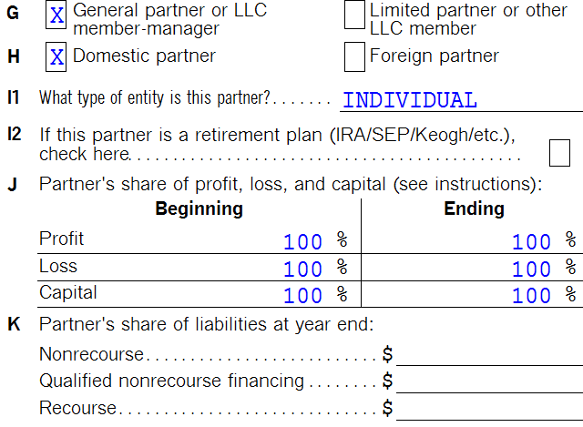
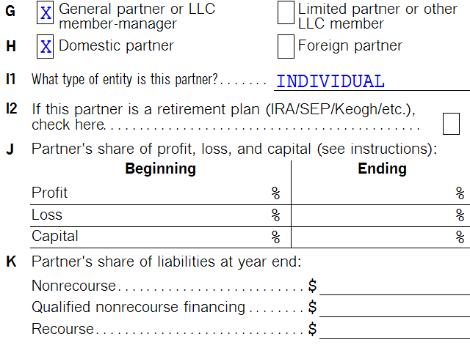
STARTING POINT
A
B
NET WORTH = $800,000
NET WORTH = $0

Slide 17
OBJECTIVE IS REALLY TO GIVE B 50% CAPITAL INTEREST
A
B
NET WORTH = $400,000
NET WORTH = $400,000

Slide 18
OBJECTIVE IS REALLY TO GIVE B 50% CAPITAL INTEREST
A
B
BUT
WE
CAN’T
NET WORTH = $400,000
NET WORTH = $400,000

Slide 19
UNDERSTANDING INTERESTS
CAPITAL INTEREST
PROFITS INTEREST
ENTITLES RECIPIENT TO A SHARE OF LIQUIDATION PROCEEDS
ENTITLES RECIPIENT TO A SHARE OF FUTURE PROFITS AND APPRECIATION

Slide 20
UNDERSTANDING INTERESTS
CAPITAL INTEREST
PROFITS INTEREST
ENTITLES RECIPIENT TO A SHARE OF LIQUIDATION PROCEEDS
TRANSFER OF CAPITAL INTEREST IS EITHER A GIFT OR TAXABLE TO RECIPIENT
ENTITLES RECIPIENT TO A SHARE OF FUTURE PROFITS AND APPRECIATION
TRANSFER OF PROFITS INTERESTS CAN BE TAX FREE TO BOTH PARTIES

Slide 21
Tax free unless
1.) SUBSTANTIALLY CERTAIN AND PREDICTABLE STREAM OF INCOME
OR
2.) PARTNER DISPOSES OF INTEREST WITHIN TWO YEARS OF RECEIPT

Slide 22
Let’s see how it works…

Slide 23
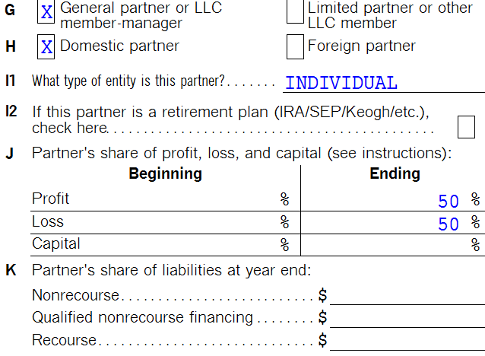
50% PROFITS INTEREST
A
B
NET WORTH = $800,000
NET WORTH = $0

Slide 24
50% PROFITS INTEREST
A
B
ASSUME
$100,000 Profits and
$100,000 Appreciation
NET WORTH = $800,000
NET WORTH = $0

Slide 25
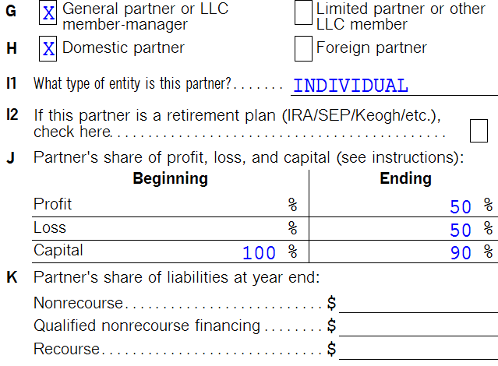
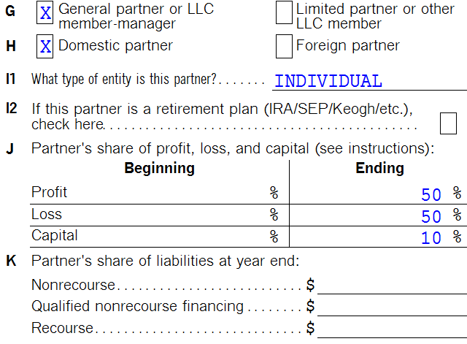
YEAR 1
A
B
NET WORTH = $900,000
NET WORTH = $100,000

Slide 26
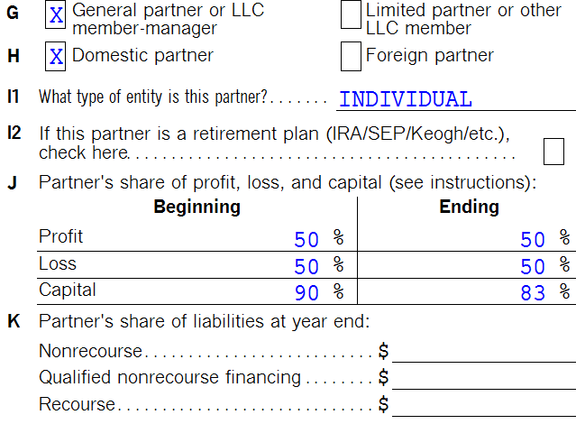
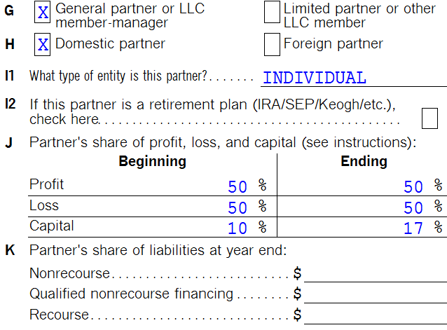
YEAR 2
A
B
NET WORTH = $1,000,000
NET WORTH = $200,000
(By the way, only paid tax on $100,000)

Slide 27
B

Slide 28
I wonder what would
happen if I let B have
75% of the profits?
A

Slide 29
B

Slide 30
BEG.
EQUITY IN LLC
CAPITAL
CONTRIBUTED
BOOK INCOME
APPRECIATION
END.
EQUITY IN LLC
DRAWS
BOOK LOSSES
DEPRECIATION

Slide 31
OPPORTUNITIES –
FACTORS WE CAN “CONTROL”
1
2
3
BEG.
EQUITY IN LLC
CAPITAL
CONTRIBUTED
BOOK INCOME
APPRECIATION
END.
EQUITY IN LLC
DRAWS
BOOK LOSSES
DEPRECIATION
Which of the three can we “control”?

Slide 32
OPPORTUNITIES –
FACTORS WE CAN “CONTROL”
1
2
3
EQUITY IN LLC
CAPITAL
CONTRIBUTED
TAX PROFITS
APPRECIATION
EQUITY IN LLC
DRAWS
TAX LOSSES
DEPRECIATION
ACCELERATE DRAWS/ GPS
PROFITS
INTEREST
PROFITS
INTEREST
I would argue all three!!!

Slide 33
OPPORTUNITIES –
FACTORS WE CAN “CONTROL”
1
2
3
EQUITY IN LLC
CAPITAL
CONTRIBUTED
TAX PROFITS
APPRECIATION
EQUITY IN LLC
DRAWS
TAX LOSSES
DEPRECIATION
ACCELERATE DRAWS/ GPS
PROFITS
INTEREST
PROFITS
INTEREST
I would argue all three!!!

Slide 34
BEG.
EQUITY IN LLC
CAPITAL
CONTRIBUTED
TAX PROFITS
APPRECIATION
END.
EQUITY IN LLC
Three ways to build equity in LLC.
Which is the best?

Slide 35
Already paid tax on these!!!
BEG.
EQUITY IN LLC
CAPITAL
CONTRIBUTED
TAX PROFITS
APPRECIATION
END
EQUITY IN LLC
Ticking
time bomb!?!

Slide 36
Solution: “Diversify”… Gain Equity by all three methods?
EQUITY IN LLC
$8 Million
CAPITAL
CONTRIBUTED
TAX PROFITS
APPRECIATION
EQUITY IN LLC
$8 Million

Slide 37
OTHER CONSIDERATIONS
Depreciation during down cycles… plan backfires?
Power of the Guaranteed Payment
Family Partnership Rules, and other ambiguities
Built In Gains on Contribution

Slide 38
B

Slide 39
Power of the guaranteed payment
In the real world…
Both A and B need cash from the business
BEG.
EQUITY IN LLC
CAPITAL
CONTRIBUTED
BOOK INCOME
APPRECIATION
END.
EQUITY IN LLC
DRAWS
BOOK LOSSES
DEPRECIATION
A should take a Draw
B should take a GP

Slide 40
Summary
Here’s the top 4 slides in case you zoned out…

Slide 41
UNDERSTANDING INTERESTS
CAPITAL INTEREST
PROFITS INTEREST
ENTITLES RECIPIENT TO A SHARE OF LIQUIDATION PROCEEDS
TRANSFER OF CAPITAL INTEREST IS EITHER A GIFT OR TAXABLE TO RECIPIENT
ENTITLES RECIPIENT TO A SHARE OF FUTURE PROFITS AND APPRECIATION
TRANSFER OF PROFITS INTERESTS CAN BE TAX FREE TO BOTH PARTIES

Slide 42
Tax free unless
1.) SUBSTANTIALLY CERTAIN AND PREDICTABLE STREAM OF INCOME
OR
2.) PARTNER DISPOSES OF INTEREST WITHIN TWO YEARS OF RECEIPT

Slide 43
BEG.
EQUITY IN LLC
CAPITAL
CONTRIBUTED
BOOK INCOME
APPRECIATION
END.
EQUITY IN LLC
DRAWS
BOOK LOSSES
DEPRECIATION

Slide 44
OTHER CONSIDERATIONS
Depreciation/losses during down cycles… plan backfires?
Power of the Guaranteed Payment
Family Partnership Rules, and other ambiguities
Built In Gains on Contribution

Slide 45
Thank you

