Slide 1
FAST
Gary Schnitkey
University of Illinois

Slide 4
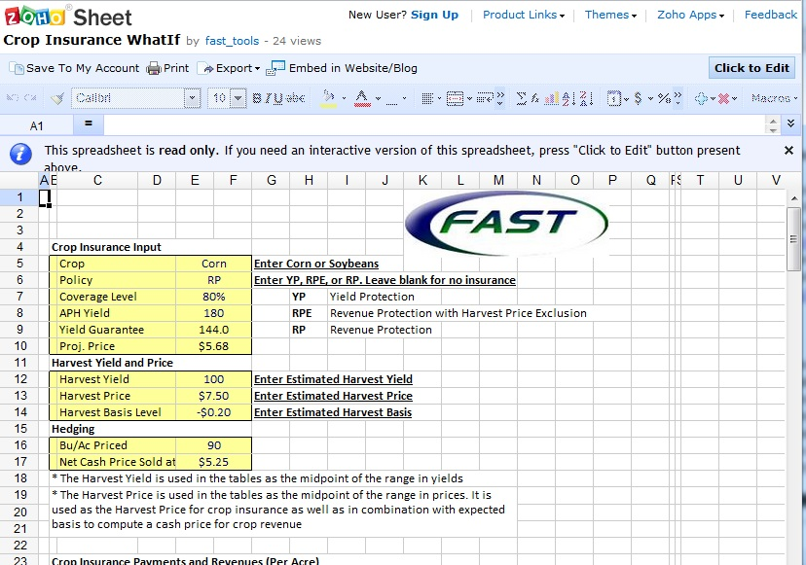

Slide 5
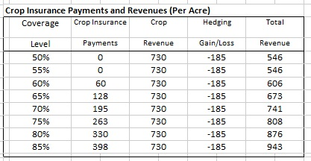
Grain Farm Incomes

Slide 6
